Slide 1


Alpha Prototype: Agricultural rover
Team Charlie
Ingmar Diaz, Aakansha Bhatt, Anshu Paudyal, Raunaq Chopra, Michael Foster, Yang Ye
12th Feb 2021

Slide 2
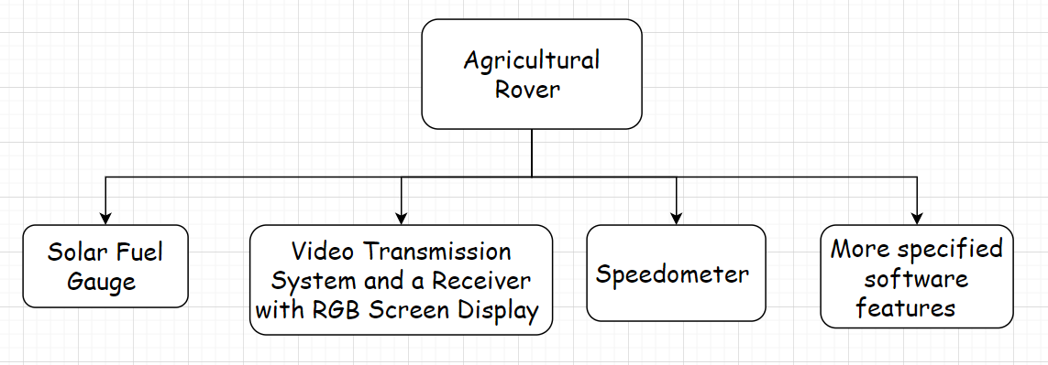
Introduction

Slide 3
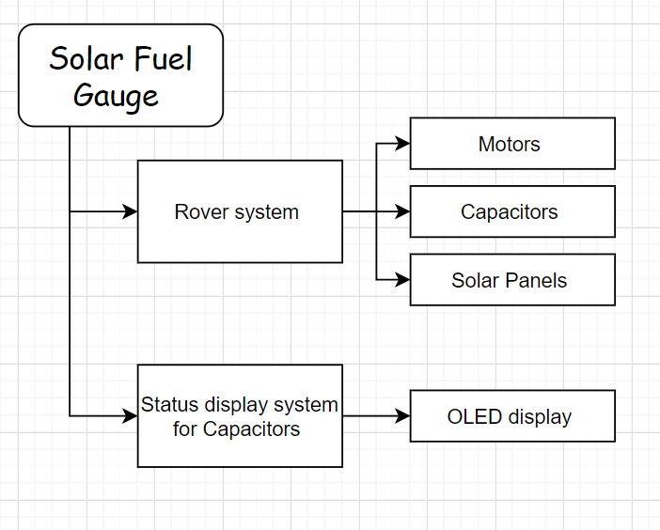
Solar Fuel Gauge

Slide 4
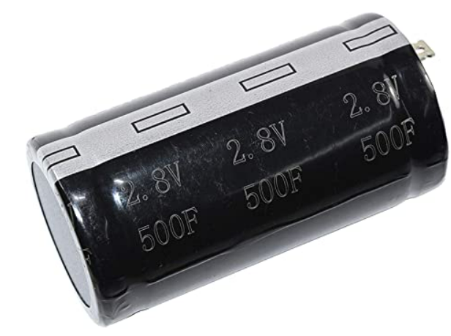
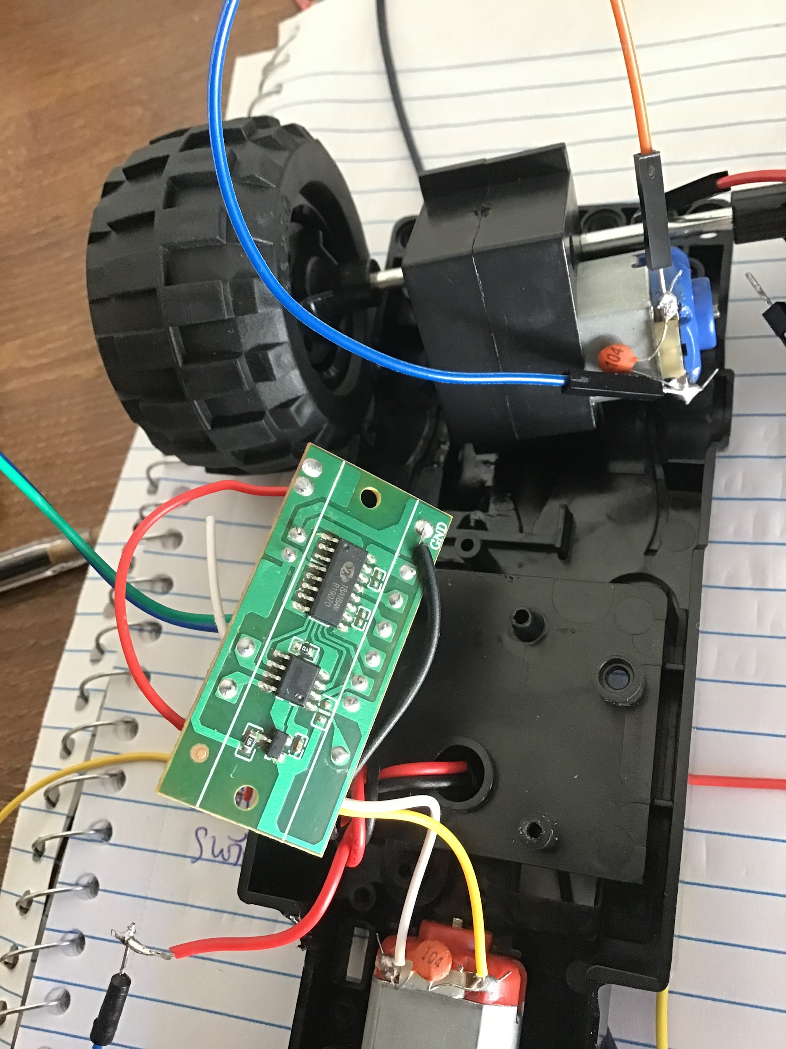
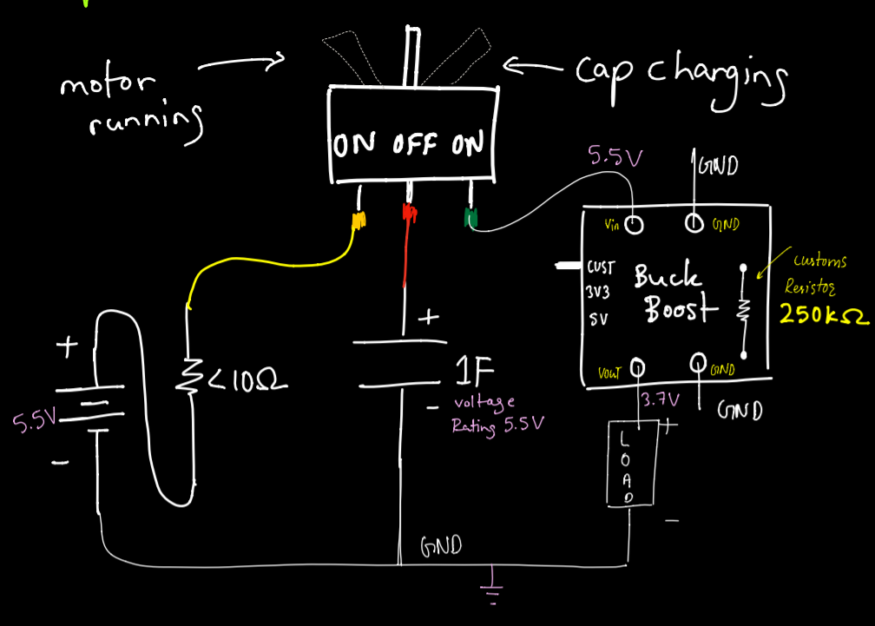
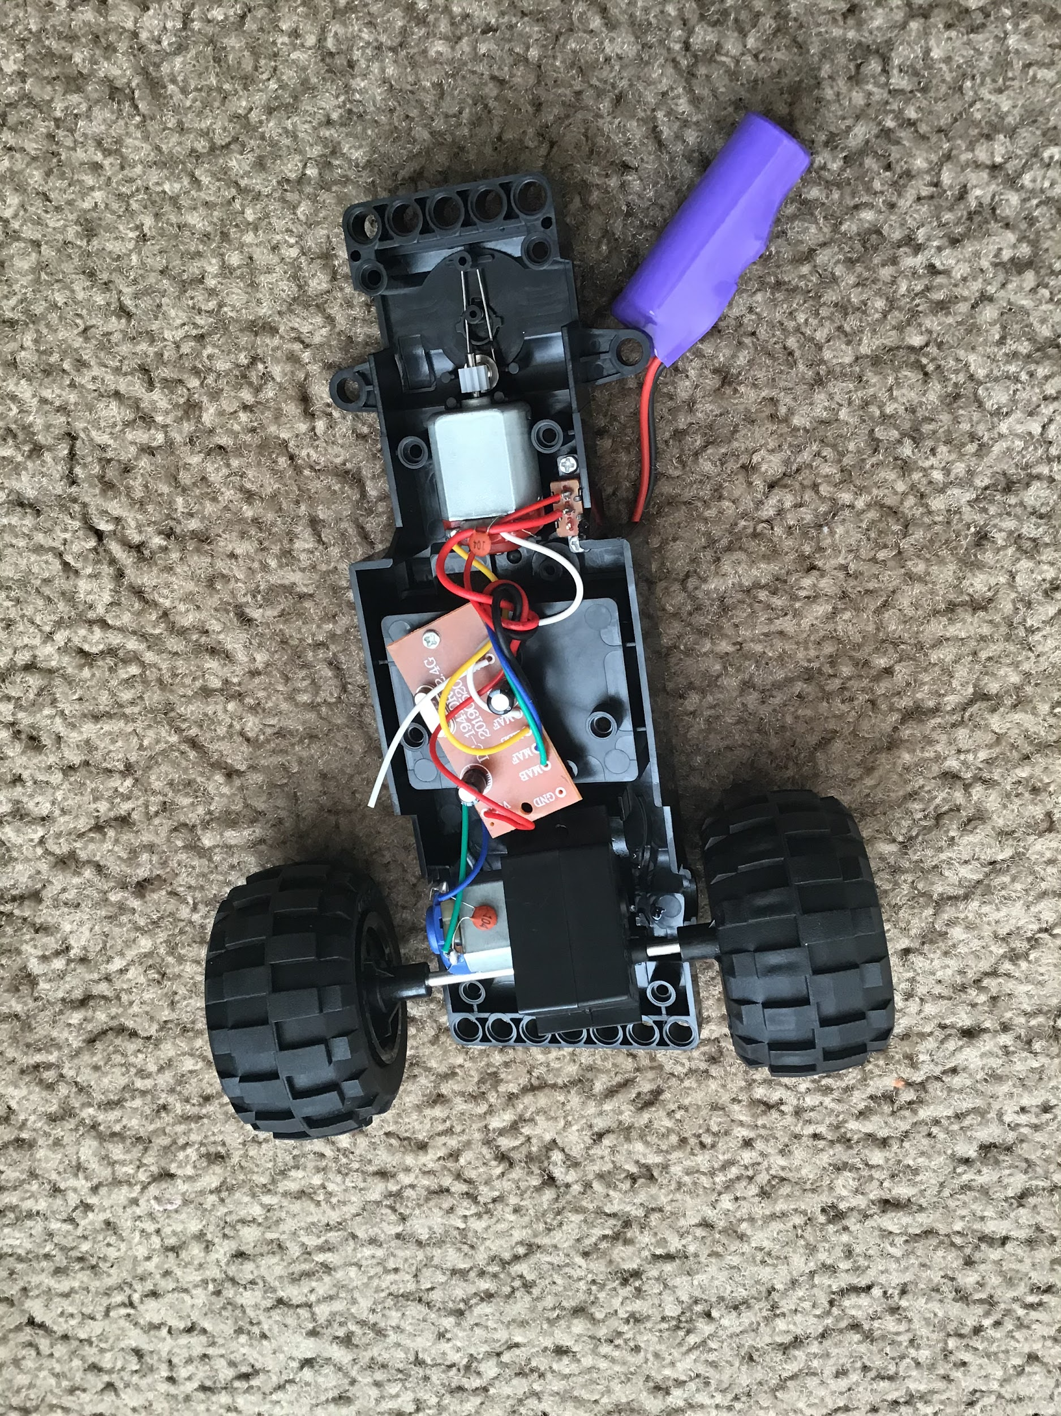
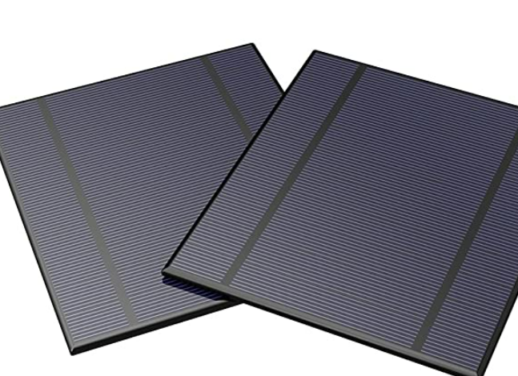
Rover system
500F
H-bridge & voltage regulator
Rough schematics
Rover
Solar Panel

Slide 5
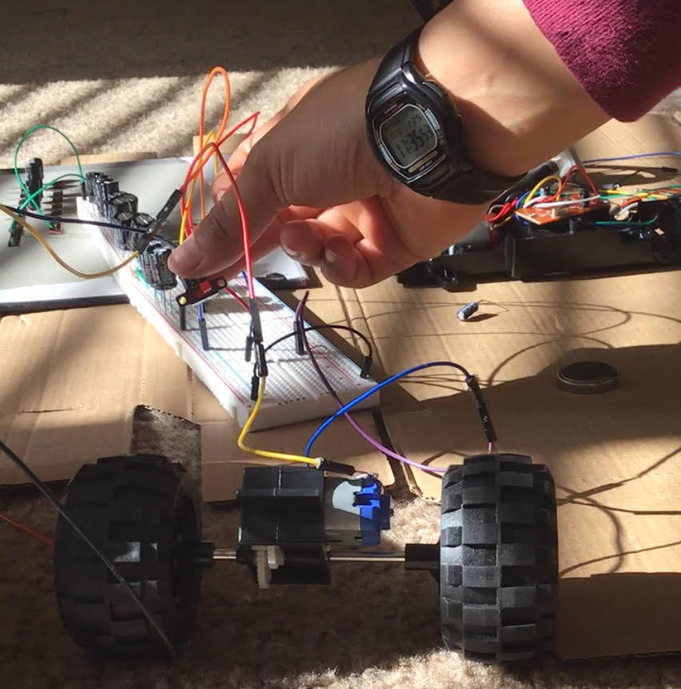
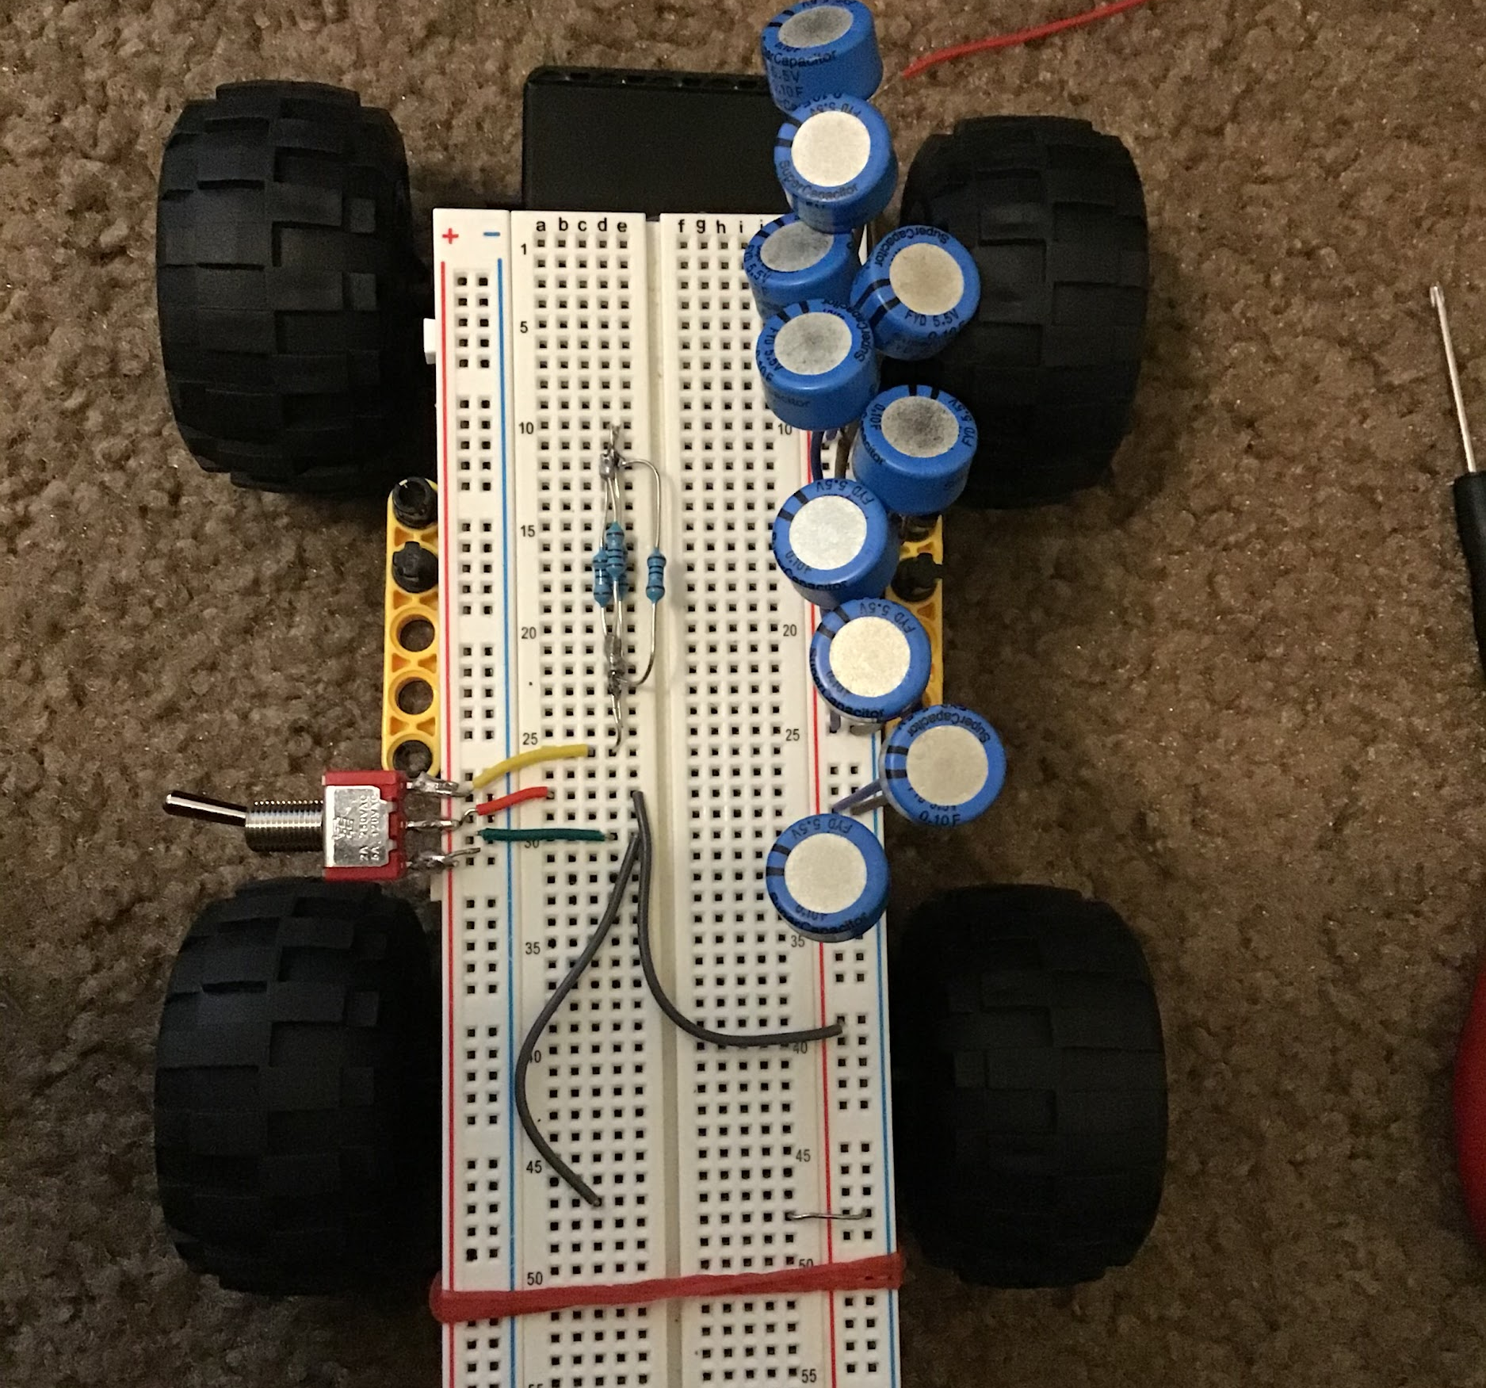
Capacitor: 18mF
Run time: 0.39 sec
Capacitor: 1F
run time: 12 sec (just one motor)

Slide 6
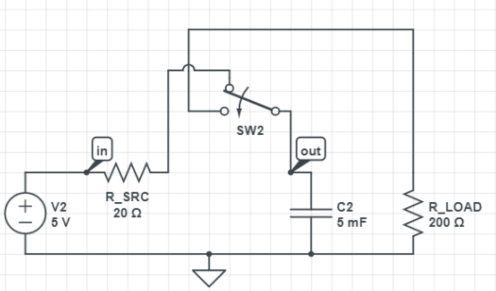
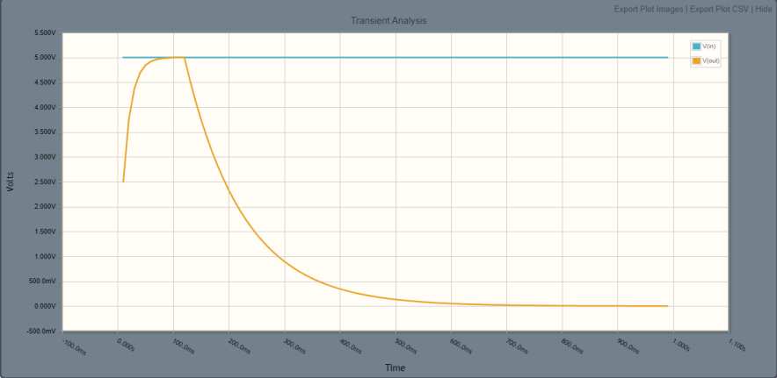
Power Analysis
Capacitor
1F
voltage rating: 5.5V
charge stored = 5.5C
stored energy = 0.015125 kJ
capacity of only 2.7mAh
Rechargeable battery
3.7V
capacity of 400mAh
energy stored is 1.48kJ
Conclusion: No issue with H-bridge
If we get two 350F caps with Voltage rating 2.7 each, put them in series which gives voltage of 5.4 and capacitance of 175F. The energy stored will be 2.55 kJ and the capacity will be 472.49 mAh. Which is pretty close to the battery that came with the rover.

Slide 7
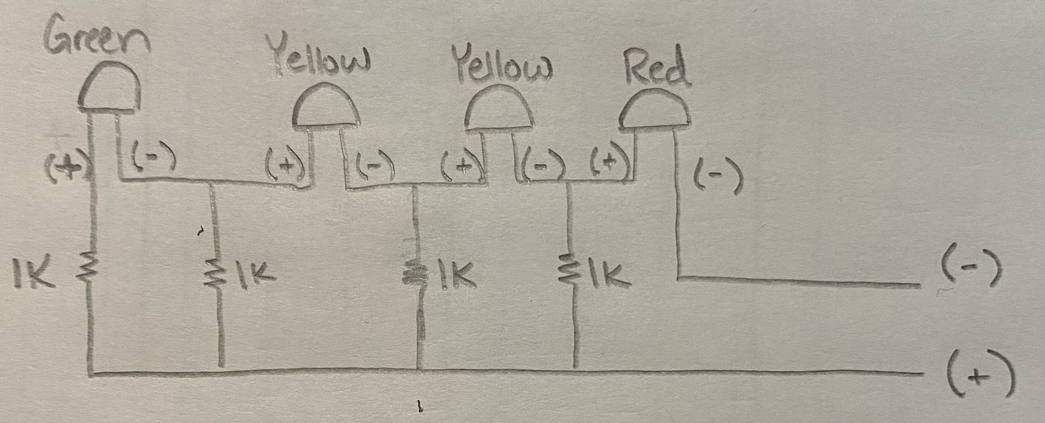
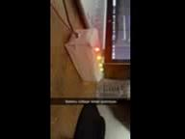
Status display system for Capacitors
Above is the schematic for this simple voltage circuit
which sets off certain LEDs depending on the voltage driven through it. The video resolution is bad, but you can still make out the different color LEDs.
-Red LED ~ 0-1V
-Yellow LEDs ~ 1-3V
-Green LED ~ 3-4V

Slide 8
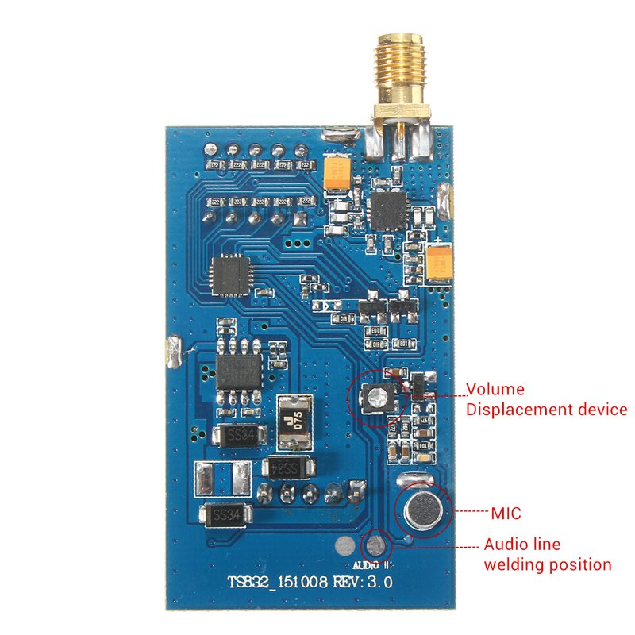
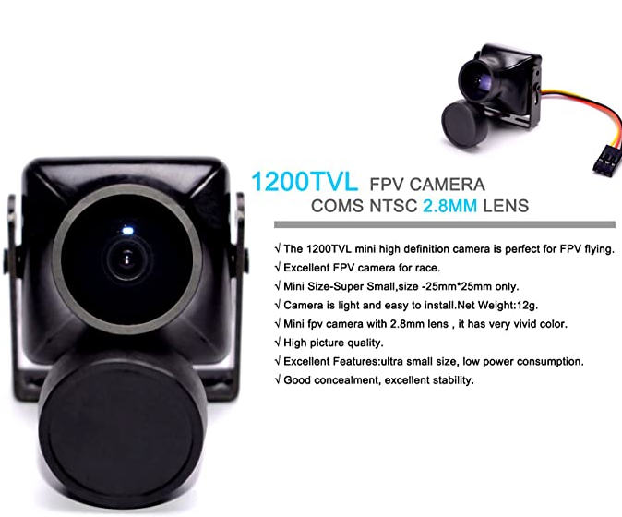

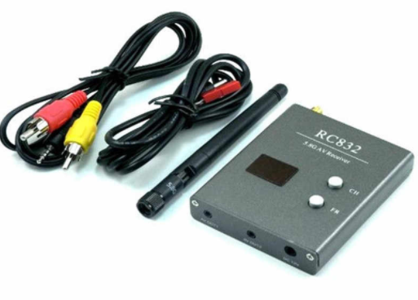
Video Transmission & Receiver with RGB Display
The video captured by the camera can be transmitted by a transmitter to an AV signal receiver. Then AV video signal will be processed and connected to a RGB screen for display.
The Transmitter used is the TS835.
The Receiver used is the RC832.
The display used is a RGB signal display screen.
The Camera used is ZMR250.

Slide 9
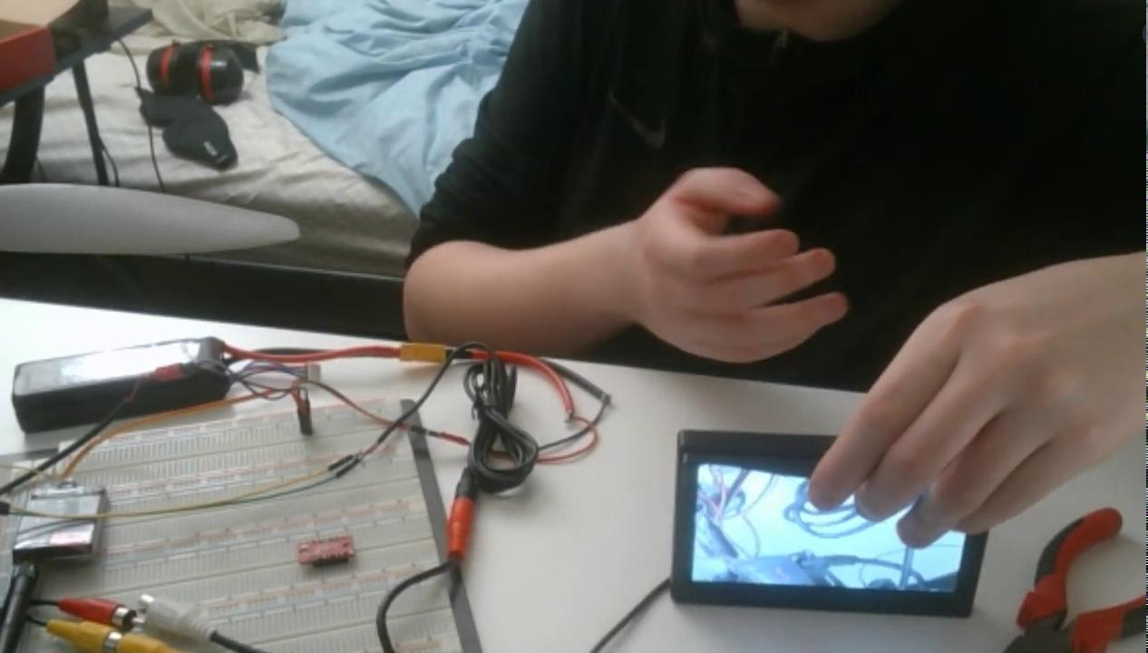

Slide 10

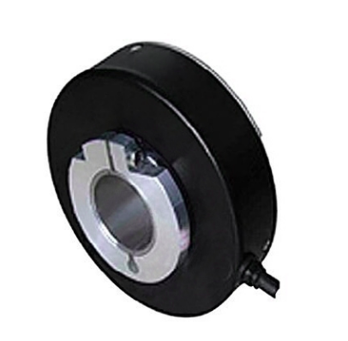
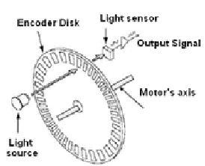
Speedometer
Using the Accelerometer, we used the area under the curve to find the speed of the body after finding the acceleration in the x, y and z directions using the formula below.
Since the accelerometer is not the best device to use for speed, we are planning on using a shaft encoder, to record the speed using the rotation of the wheels. The shaft encoder basically calculates the distance covered by a wheel or the amount the wheel rotates over a given time to accurately find the distance.
The speedometer displays the increase in speed as we accelerate in the forward or the reverse direction, the way we expect it to work.

Slide 11
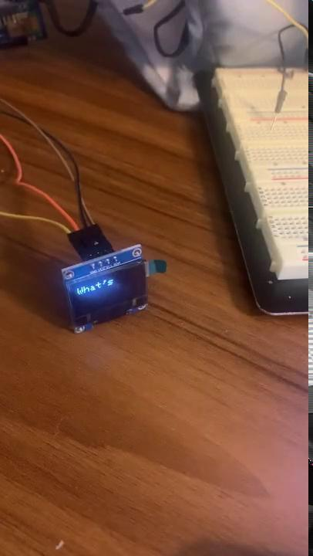
OLED Display
OLED Display SSD1306
128x64 pixels
3.3-5V
Uses I2C Communication
Future Display Implementations:
Fuel Gauge Data
Speedometer Data
Temperature Data
Moisture Data

Slide 12
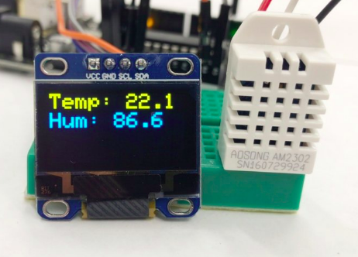
Temperature and humidity sensing
Since the combination of the accelerometer and PsoC 6 is also used to measure the current temperature, we use the device to record the temperature which would be later displayed on the OLED.
We would try to implement humidity measurements as well. However, since the accelerometer does not have an embedded humidity sensor, we would implement it using another sensor along with a soil moisture detector sensor.
Figure shows an example of a completed display

Slide 13
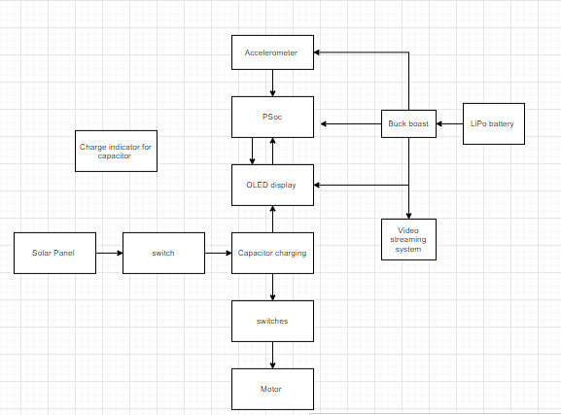
System Flowchart

Slide 14
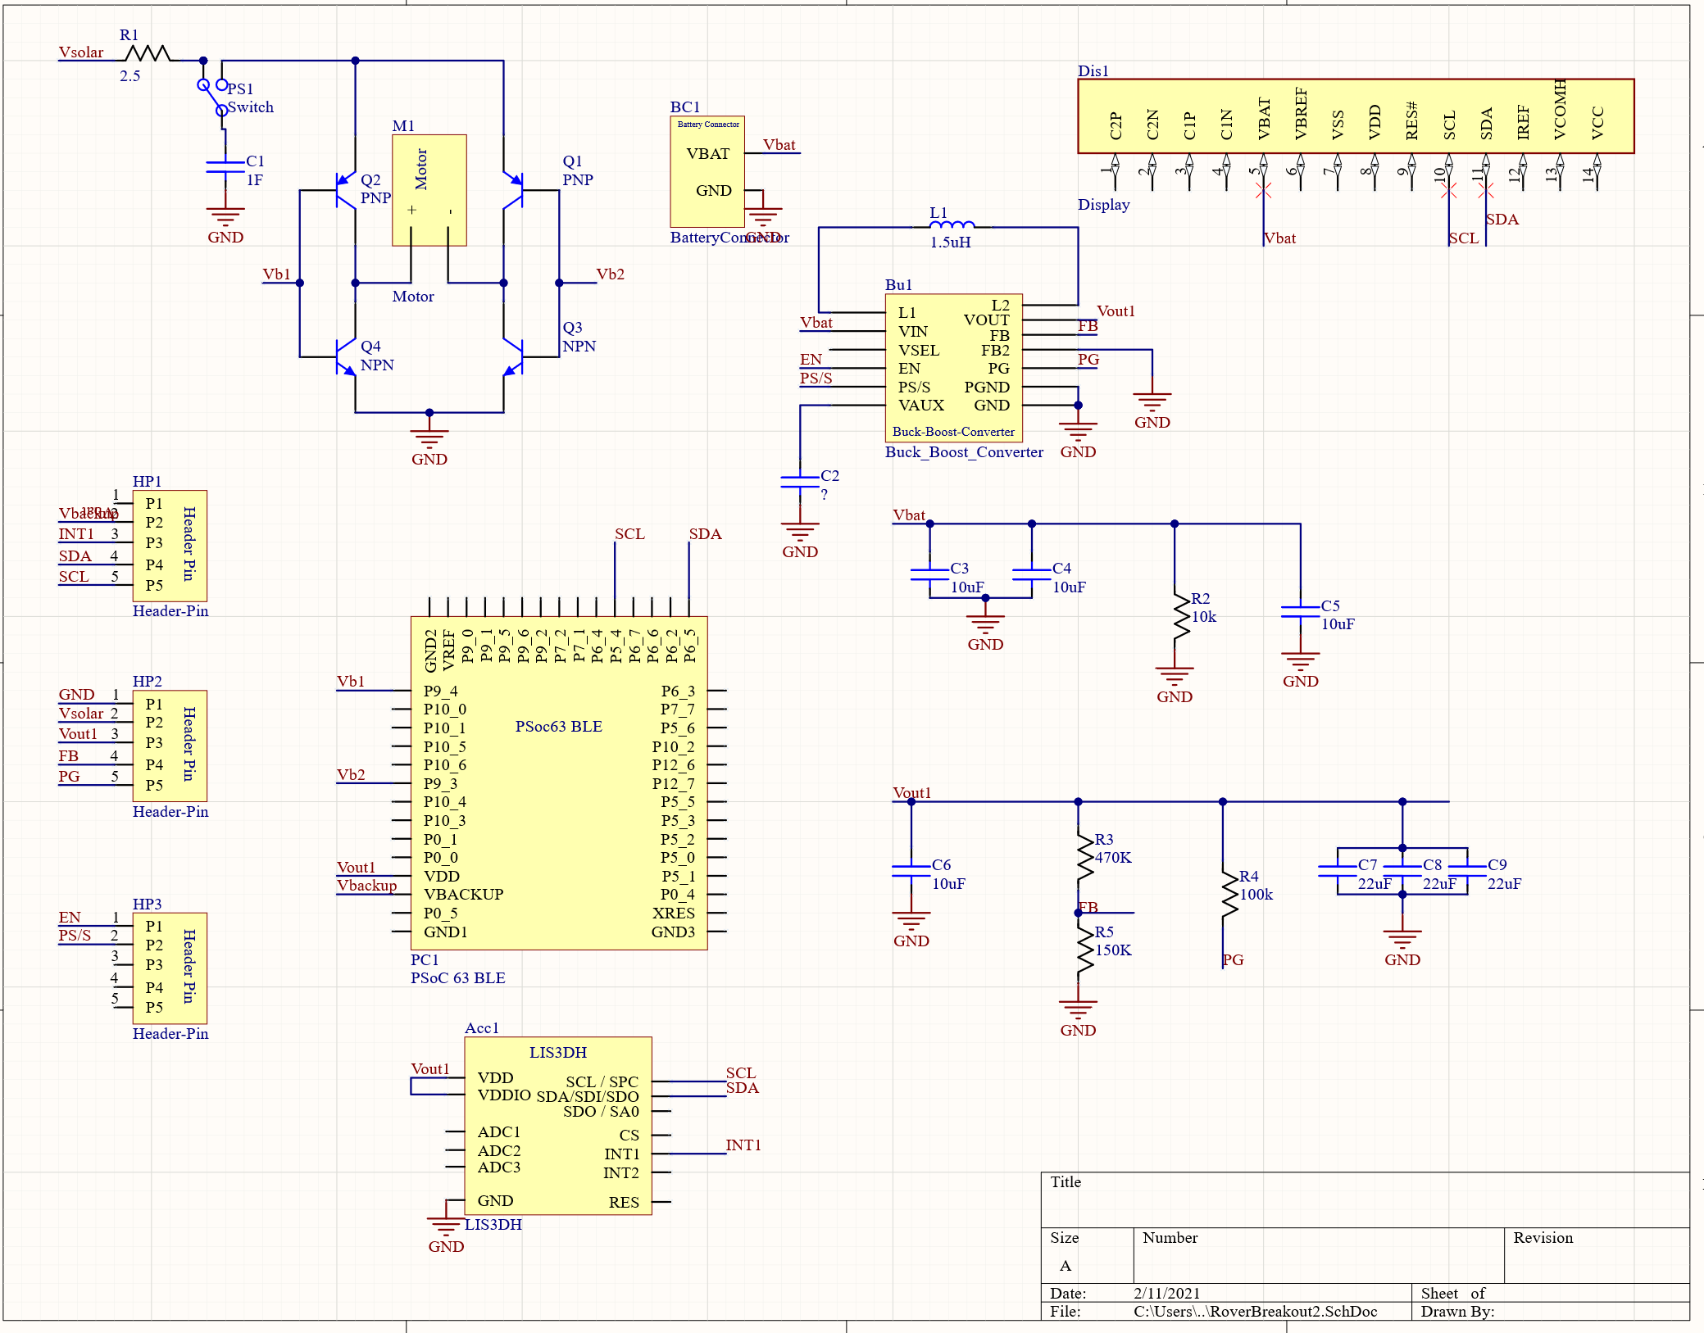
Altium Schematic

Slide 15
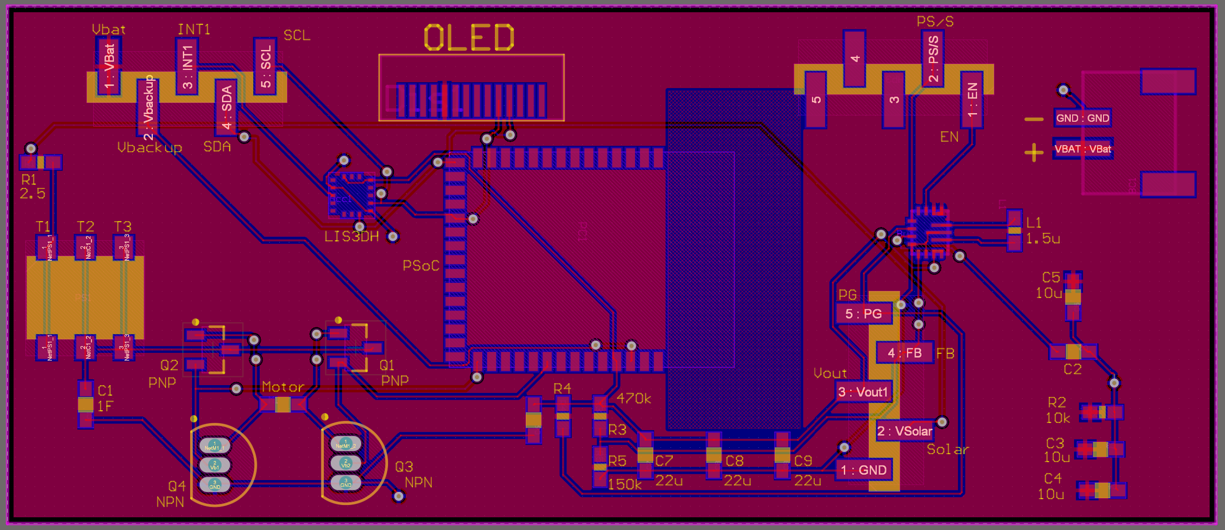
Altium PCB

Slide 16
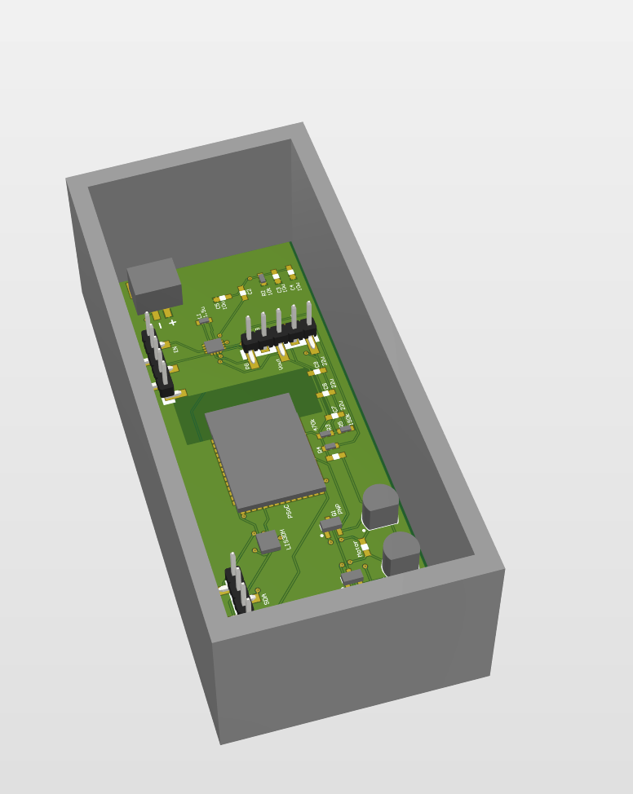
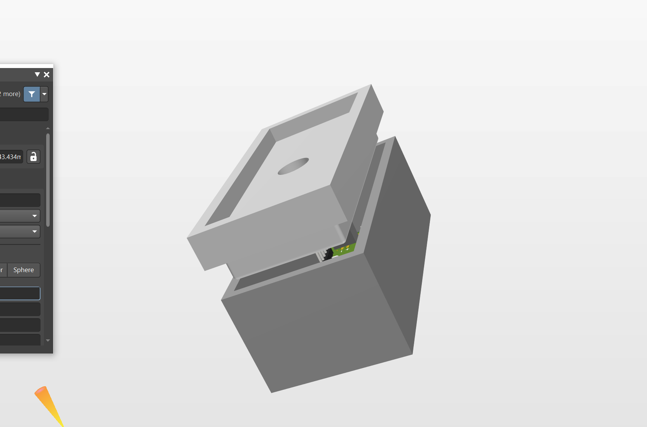
3D enclosure

Slide 17
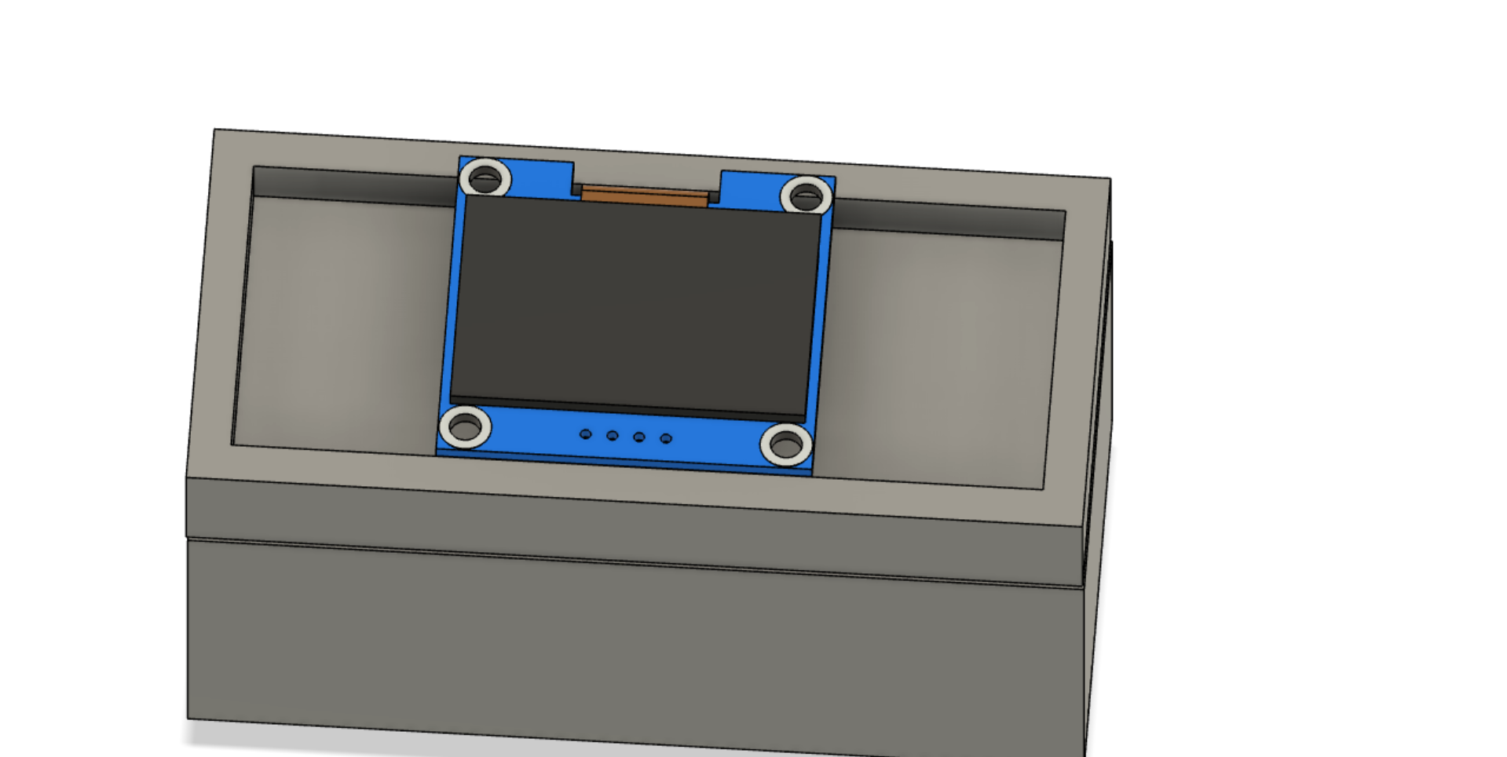
3D enclosure

Slide 18
Budget
Rover Truck ~ $41.79
Solar Panels ~ $12.99
SPDT switches ~ $13.00
10x*0.1F capacitors ~ $8.28
Box of capacitors ~ $18.39
Shipping for Switches and cap ~ $13.39
Other Shipping Costs ~ $32.64
Total Spent ~ $184.17
Current Budget Left ~ $315.56

Slide 19
For Beta Prototype
Transition fuel gauge analog implementation to OLED Display
Humidity and soil moisture sensing
Implementation of H-bridge for the rover’s motor control
Notifying user regarding the battery conditions and location (GPS)

Slide 20
Reference
Reference:
https://www.omnicalculator.com/physics/capacitor-energy https://jumk.de/math-physics-formulary/capacity.php

